Slide 1



COSC 2100
Form Controls and UI

Slide 2
OOP II
COSC 2100
Visual Studio

Slide 3


Visual Studio
Visual Studio is Microsoft’s flagship Integrated Development Environment (IDE)
It is well-known for being “bulky” but having a lot of robust and useful features and supports
Visual Studio supports many programming languages – not just .NET languages
Programs could also be written in any editor and then compiled in Visual Studio
Used for desktop applications, console applications (i.e. text-based), or web applications

Slide 4
Folders in Visual Studio
Bin and Obj Folders:
bin\Debug folder holds the files needed to run the program in the debugger
Compiled versions are placed in the Release folders
To distribute an application, only the .exe file is needed
Project Resources:
Resources folder generally holds resources added to a project
Graphics, sound files, text assets
Each form has a resource file with a .resx extension holds pointers to the files in the Resources folder
Supplies the resources to the form at compile time

Slide 5
Interdependent Files in Visual Studio and .NET
Visual Studio and the .NET Framework have a lot of dependencies – files and resources that find each other by relative addresses, etc.
Programs in this environment are very sensitive to being moved or renamed, so avoid this when you can and be careful with it when you must!

Slide 6
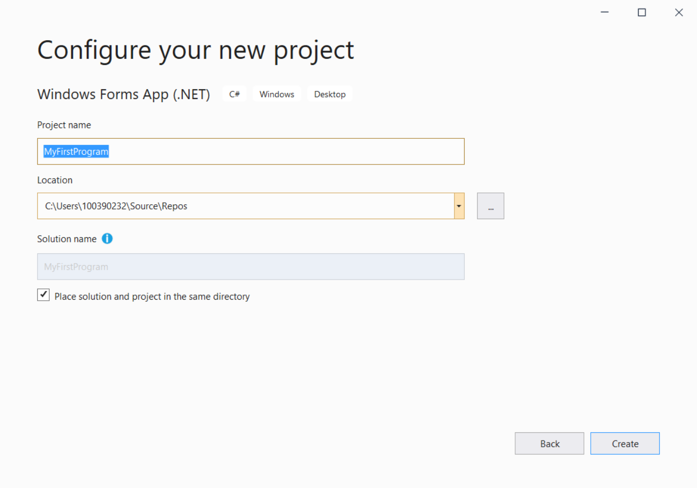
Starting a Project in Visual Studio
When you open Visual Studio, pick “Start a New Project”
Somehow select “C#” and “Windows Forms App (.NET)”
Name the project carefully since renaming it later is hard. Use PascalCase to conform to our style guide. Something like, “MyFirstProgram” or “Awesomeness”
Click “Create”

Slide 7
OOP II
COSC 2100
Designing a Form in Visual Studio

Slide 8
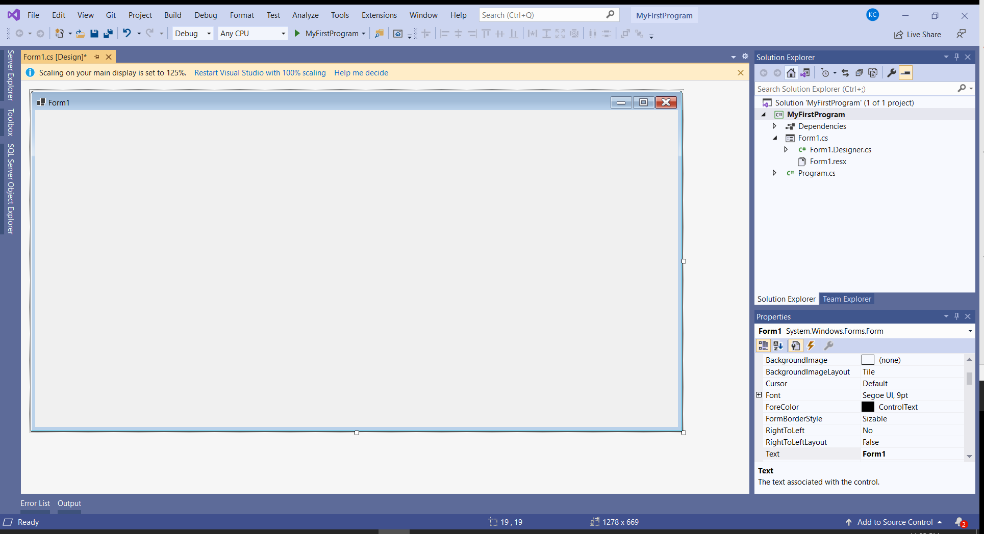
Looking At Your Form
You should have a big blank form like this one
If you don’t, note the Window on the right titled “Solution Explorer” and double-click “Form1.cs”
The Solution Explorer lists the files associated with this application
Generally, you’ll probably want to keep the layout of Visual Studio like default
You can reset the layout by going to Window -> Reset Window Layout

Slide 9
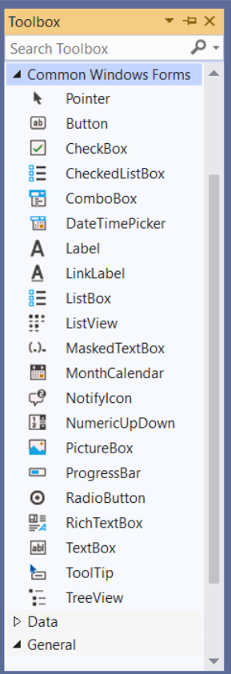
The Toolbox
On the left hand side you should see a little tab labelled “Toolbox”
You can open this – and maybe pin it – and see a list of common controls
Many control types should be familiar from what you did previously in tkinter (or whatever)
Label – displays non-interactive text
Button – accepts click events
RadioButton – select one choice from a list of things
TextBox – accepts text input (like “Entry” in tkinter)
Go ahead and drag a couple of controls onto the form

Slide 10
Common Issue #1 of 129301
It is very common for a student to accidentally end up in a code editor with an empty event handler
Worse, if you try to delete the empty event handler, everything stops working
This happens when you double-click a form control – Visual Studio tries to create a default event handler for that control
For now, just ignore it and go back to the design view – don’t delete anything

Slide 11
OOP II
COSC 2100
The Properties Window & Accessibility

Slide 12
Properties
In Visual Studio’s Design View, the Properties Window appears at the bottom-right by default
Click any control or the form itself to see properties related to this control
There’s a big list and these vary between control types
Be particularly aware of:
Name – we want our form controls to follow our style guide and we want them to be easy to identify when we’re coding
Text – usually, this is the text that the user can see on the control, or for the form object it’s the title bar text

Slide 13
Accessibility Features
Accessibility standard compliance (like for AODA) matters a lot and it is not very effective in tkinter so it wasn’t emphasized in PROG 1205
Accessibility standards are part of our style guide and it happens many of them relate to properties

Slide 14
Important Accessibility Feature #1: Contrast and Legibility
We need to ensure we haven’t picked terrible colours, tiny fonts, or heavily stylized fonts like this
If you keep these things default, you’re fine!
You could also make the fonts bigger if you like
Some fonts that come up when discussing accessibility (for the curious):
Helvetica
OpenDyslexic abcdefghi abcdefghi
Arial abcdefghi
Comic Sans abcdefghi
Century Gothic abcdefghi

Slide 15
Important Accessibility Feature #2: Tab Order
Tab order allows users to access controls without a mouse
This is very useful for users with limited or no sight, or limited dexterity
It’s also often faster for impatient professors marking your work ☺
Identify the “reading order” of every single control on the form, and set their TabIndex property in order, starting from 0 or 1
You can also go to View -> Tab Order to quickly mass-set the tab order for all controls
Consider including controls that can’t accept focus, such as Labels – it is harmless and sometimes carries benefits

Slide 16
Important Accessibility Feature #3: Access Keys
Access keys (or “hotkeys”) are ways to access or activate a control using a keyboard combination
In Windows standards, these are typically done using Alt plus a relevant letter, and the letter is indicated with an underline
You can make a hotkey without writing code in a Windows form by setting the Text property of a control with an ampersand (&) before the letter (e.g. “&Calculate”, “C&lear”: Alt+C runs Calculate, Alt+L runs Clear)
This gets the whole thing working, including the underline, and is preferred to writing custom code to do it

Slide 17
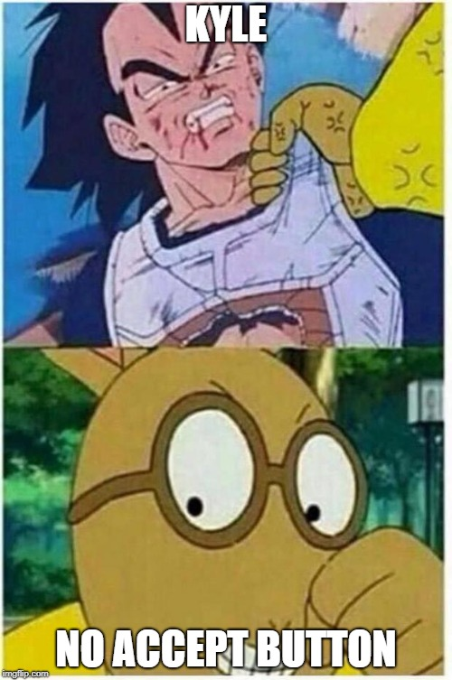
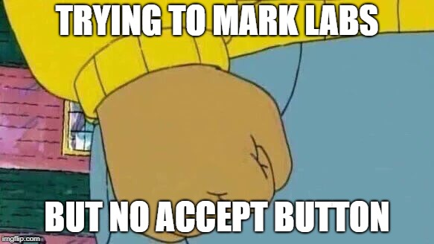
Important Accessibility Feature #3B: AcceptButton
Another important form of keyboard access
Set the AcceptButton property of the form to set a default behavior for the Enter key
Set the CancelButton property of the form to set a default behavior for the Esc key

Slide 18
Important Accessibility Feature #4: Tooltips
Tooltips aren’t just advice – although advice can be useful!
They are also the content that gets read to a user in certain screen reading softwares, and thus critically important for software access for the blind
Adding tooltips to Windows Forms is an unusual process:
Drag a new tooltip object onto the form from the toolbox
Give it a name that conforms to the style guide
This adds a tooltip property to every other object on the form
Go to each control that users can interact with and write a tooltip in the tooltip property

Slide 19
OOP II
COSC 2100
Event Handlers

Slide 20
Coding for a Windows Form
In this course, we’re only working on Windows Forms
Generally they don’t do anything unless something else takes place:
Click a button
Enter some text
Move the mouse
etc.
Programming for these behaviours is called “Event Driven Programming”, and all of our programming is going to be in response to an event
To make things happen in WinForms, we code “Event Handlers”

Slide 21
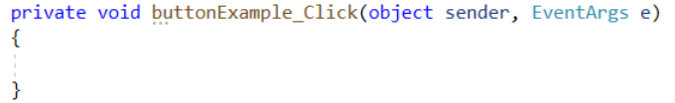
Event Handlers
You can double-click any form control to create a default event handler for that control
If I double-click a button, I go into the “codebehind” file and see an event handler like the one above
This is the set of instructions that I want to happen when the button named “buttonExample” is clicked
If I write in there, MessageBox.Show(“You clicked it”); …

Slide 22
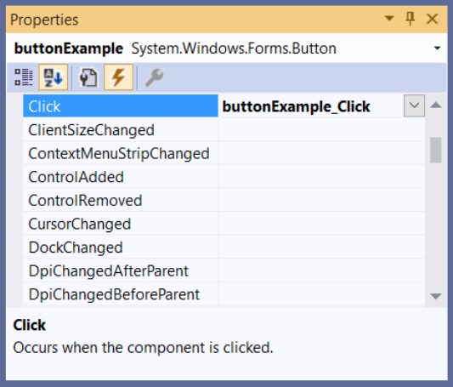
Event Handler Wiring
Earlier I mentioned that deleting an event handler can cause issues
Something Visual Studio does for us is “wiring” – creating a relationship between the button object on the form and the button’s event handler in the code
You can view event wiring in the design view by clicking on the Properties window and the lightning icon
We won’t really be using this for much yet

Slide 23
C# Coding Part 1
What is “private void buttonExample_Click(object sender, EventArgs e)”?
“private“ is an access specifier – we’ll worry about that later
“void” is the “return type” – what value do we expect back from this event handler? In this case, it’s nothing at all, or “void”.
“buttonExample_Click” is an automatically generated name for this event handler, which is technically a function – it is also kind of a bad name
Since buttonExample_Click is a function – like in Python, that means “object sender“ and “EventArgs e“ are parameters

Slide 24
C# Coding Part 2
How about this?: MessageBox.Show(“You clicked it”);
“MessageBox” is an identifier type – it’s technically referring to a MessageBox class from the .NET Class Library
That means “Show” is a method of the MessageBox class
“You clicked it” is a parameter of the Show method of the MessageBox class
Finally, in C#, every code statement is completed by a semicolon (;)

Slide 25
Form Controls and Layout
COSC 2100
About Form Controls

Slide 26
Brief Review: The .NET Framework
What is the .NET Framework?
Why are we using the .NET Framework?

Slide 27
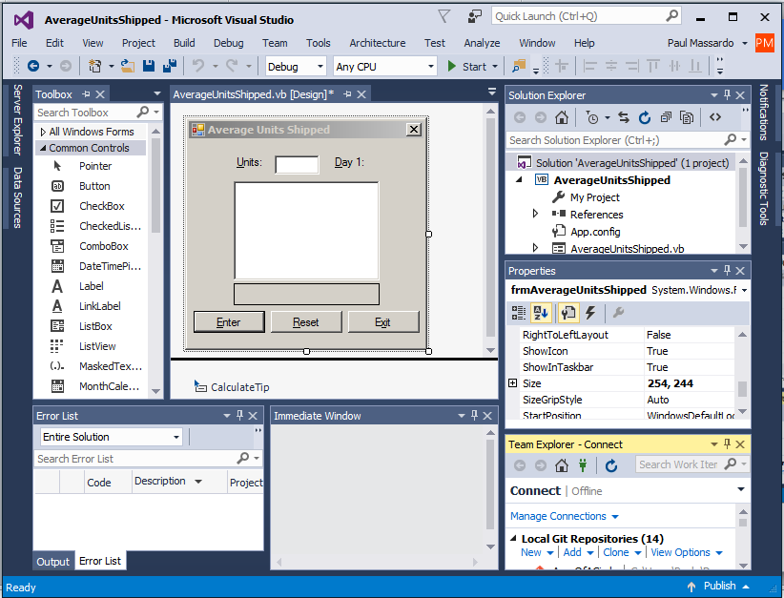
Brief Review: Visual Studio Features
Toolbox
Solution Explorer
Properties
Window
Form Designer
Team Explorer
Error List
Immediate Window
Notes:
What if I accidentally close a window?
View Menu – Toolbox/Error List/Solution Explorer/Properties Window
Debug Menu>>Windows – Immediate Window
Window -> Reset Window Layout
We didn’t use some of these; they are all in the default layout, but there are tons of additional windows that can be used.

Slide 28
Form Controls You Should Already Know
The following form controls are pretty simple, and equivalent controls were definitely covered in PROG 1205:
Label
TextBox
Button
You may also have used these:
RadioButton
CheckBox
Any others?

Slide 29
Other Common Controls
ComboBox
GroupBox
ListBox
NumericUpDown
There are literally hundreds of other controls including many we will use later on

Slide 30
Windows Form Controls: Label
Labels display text that the user can’t directly manipulate
Labels can’t be selected and can’t receive focus
The default event handler is “Click”
In some environments, labels that aren’t used in code aren’t named at all
Most common use is to identify some other control on a form

Slide 31
Windows Form Controls: TextBox
TextBoxes are equivalent to the “Entry” type in tkinter
Textboxes are intended for data entry
The default event handler is “TextChanged”
Textboxes can be set to ReadOnly if you don’t want the user to modify their contents
In fact, if you wanted to, you could adjust the properties of a Textbox so that it would appear and behave exactly like a Label (but that would be silly)

Slide 32
Windows Form Controls: Labels and Textboxes
For an output field, should you use a Label or a Textbox?
Why?
Notes:
Data integrity?
Accessibility?
Usability?
There are pros and cons to both decisions.

Slide 33
Windows Form Controls: Button
Buttons are used to execute some kind of action – but they aren’t always required
Consider a temperature converter
They are usually named related to the action they do, and their text property is typically one word related to that action, too
The default event handler is “Click”

Slide 34
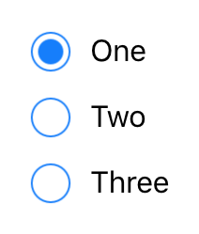
Windows Form Controls: RadioButton
RadioButtons are confusing to name; some people name them like buttons
RadioButtons are intended to allow choice of one selection from a list of selections
If there’s only one thing to choose from, consider a CheckBox instead
The default event handler is “CheckedChanged”, which executes when it is checked or unchecked

Slide 35
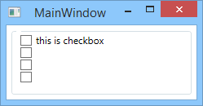
Windows Form Controls: CheckBox
CheckBoxes allow a yes/no choice, where a CheckBox’s “Checked” property is equal to True or False
The default event handler is “CheckedChanged”, which executes when it is checked or unchecked

Slide 36
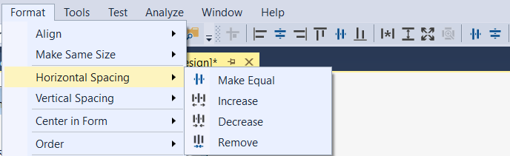
Layout for a Windows Form
This course does not emphasize design
If you’d like things laid out well, consider making use of these:
Align Left / Center / Right
Align Top / Middle / Bottom
Make Same Width / Height / Size
Space
Evenly

Slide 37
Form Controls and Layout
COSC 2100
Accessibility Features (sort of review, but it’s worthwhile)

Slide 38
Accessibility for a Windows Form
This course DOES emphasize accessibility
All of your forms should be completely usable by someone without a mouse / trackpad
Why?
Accessibility features:
Contrast – don’t pick conflicting background colours
Tab Order – follow the intended workflow of the tool, or a natural reading order
Hotkeys – for all controls the user needs to use
AcceptButton – default action for your form
Tooltips – on all controls the user needs to use
Notes:
Mention AODA compliance and style guide.

Slide 39
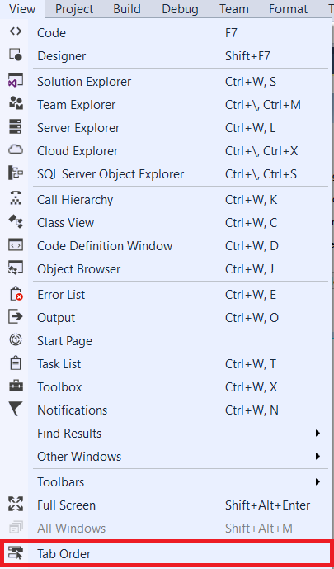
Setting Tab Order
Tab Order can be set by individually setting the TabIndex property of the controls on the form
Typically it’s suggested to follow a western-styled reading order (left to right, top to bottom)
It’s generally a good idea to include every single control, even Labels
Want a shortcut and a handy way to check Tab Order?

Slide 40
Setting Access Keys (Hotkeys)
Hotkeys are set on the Text property for a Label, Button, RadioButton or CheckBox by putting an “&” before the character we want to be used for access – then activated using the Alt key with that character
You can’t do this with TextBoxes - why?
Setting a hotkey for a TextBox is done using a Label with careful consideration of Tab Order
It is also possible to make a hotkey work by coding an event handler for a specific keypress but… why?

Slide 41
PLEASE REMEMBER TO SET THE ACCEPTBUTTON PROPERTY OF YOUR FORM

Slide 42
Review: Tooltips
ToolTips are the content that gets read to a user in certain screen reading softwares, and thus critically important for software access for the blind
For Windows Forms, ToolTips are technically form controls
You only need one ToolTip object on each form
Adding tooltips to Windows Forms is an unusual process:
Drag a new ToolTip object onto the form from the toolbox This adds a tooltip property to every other object on the form
Give it a name that conforms to the style guide
Go to each control that users can interact with and write a ToolTip in the ToolTip property

Slide 43
OOP II
COSC 2100
Event Handlers
(Included verbatim from Week 1 Slides)

Slide 44
Coding for a Windows Form
In this course, we’re only working on Windows Forms
Generally they don’t do anything unless something else takes place:
Click a button
Enter some text
Move the mouse
etc.
Programming for these behaviours is called “Event Driven Programming”, and all of our programming is going to be in response to an event
To make things happen in WinForms, we code “Event Handlers”

Slide 45
Event Handlers
You can double-click any form control to create a default event handler for that control
If I double-click a button, I go into the “codebehind” file and see an event handler like the one above
This is the set of instructions that I want to happen when the button named “buttonExample” is clicked
If I write in there, MessageBox.Show(“You clicked it”); …

Slide 46
Event Handler Wiring
Earlier I mentioned that deleting an event handler can cause issues
Something Visual Studio does for us is “wiring” – creating a relationship between the button object on the form and the button’s event handler in the code
You can view event wiring in the design view by clicking on the Properties window and the lightning icon
We won’t really be using this for much yet

Slide 47
C# Coding Part 1
What is “private void buttonExample_Click(object sender, EventArgs e)”?
“private“ is an access specifier – we’ll worry about that later
“void” is the “return type” – what value do we expect back from this event handler? In this case, it’s nothing at all, or “void”.
“buttonExample_Click” is an automatically generated name for this event handler, which is technically a function – it is also kind of a bad name
Since buttonExample_Click is a function – like in Python, that means “object sender“ and “EventArgs e“ are parameters

Slide 48
C# Coding Part 2
How about this?: MessageBox.Show(“You clicked it”);
“MessageBox” is an identifier type – it’s technically referring to a MessageBox class from the .NET Class Library
That means “Show” is a method of the MessageBox class
“You clicked it” is a parameter of the Show method of the MessageBox class
Finally, in C#, every code statement is completed by a semicolon (;)

Slide 49
OOP II
COSC 2100
Python and C# Differences

Slide 50
Python and C# Differences: Comments
Python: |  | C#:
# Filename: RectangleSpace.vb # Author: Kyle Chapman # Last Modified: January 7 |  | // Filename: RectangleSpace.cs // Author: Kyle Chapman // Last Modified: January 7
Notes:
C# also has a continuous comment block using /* comment here */ - there is no equivalent to this in Python or VB

Slide 51
Python and C# Differences: Variables
Python: |  | C#:
length = 0.0 name = "Kyle" employees = 4 |  | double length = 0.0; string name = "Kyle"; int employees = 4;
Notes:
In C#, all variables must be declared before they are used! Declarations start with either the datatype, or “var” if the datatype is obvious.

Slide 52
Python and C# Differences: Selection
Python: |  | C#:
if pizza_diameter < SMALL_DIAMETER: # something elif pizza_diameter < MEDIUM_DIAMETER: # something else |  | if (pizzaDiameter < SmallDiameter) { // something } else if (pizzaDiameter < MediumDiameter) { // something else }
Notes:
In Python, the spacing is very meaningful. In C#, blocks of code are delimited by braces: { and } The logical expressions are also surrounded by parentheses: ( and ) What else do you notice?

Slide 53
Python and C# Differences: Iteration
Python: |  | C#:
For counter in range(0, 6) print(counter) Next |  | for (int counter = 0; counter <= 6; counter++) { MessageBox.Show( counter.ToString()); }
Notes:
Again, in C#, blocks of code are delimited by braces: { and } These technically do slightly different things.

Slide 54
Python and C# Differences: More Iteration
Python: |  | C#:
For i in range(0, 20, 2) print(i) Next |  | for (int i = 0; i <= 20; i += 2) { MessageBox.Show( i.ToString()); }
Notes:
C# has the “Increment by 2” step as part of the For loop’s parameters. Python has the optional third term in the range() function. If it isn’t specified, it defaults to “1” (which is most common). You can make the step/increment value negative in either language, to count through something backwards.

Slide 55
Python and C# Differences: Relational Operators
Relational Operators in C#:
They are mostly the same. Mostly.
Notes:
C# uses “==“ for “Equal to” – same as Python, but not every language is like this
Operator | Operator Name | Example
== | Equal to | 5 == 3 is false
> | Greater than | 5 > -3 is true
< | Less than | 5 < 3 is false
>= | Greater than or equal to | 5 >= 5 is true
<= | Less than or equal to | 5 <= 3 is false
!= | Not equal to | 5 != -5 is true

Slide 56
Python and C# Differences: Logical Operators
Python: | C#: | Description:
And Or Not | && || ! | Returns a True value if both expressions are True. This operator evaluates both expressions. Returns a True value if either expression is True. This operator evaluates both expressions. Reverses the value of an expression.

Slide 57
Python and C# Differences: Typing
Python is strongly typed, but has implicit types and only a few of them
C# has a whole lot of data types!
Sometimes we need to be careful with these; it’s not always easy to combine the use of integers and doubles/floats

Slide 58
OOP II
COSC 2100
Solutions and Projects

Slide 59
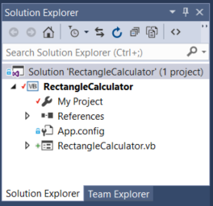
Solutions and Projects
A “solution” can contain several projects, which are typically related
Recommendation: make ONE solution called NETD2202 and include all of your Labs as projects
This might make our final project simpler later
We are creating C# Windows Forms Apps (.NET)
Make sure you name the Project/Solution properly when you start!
Solution
Project
Code File

Slide 60
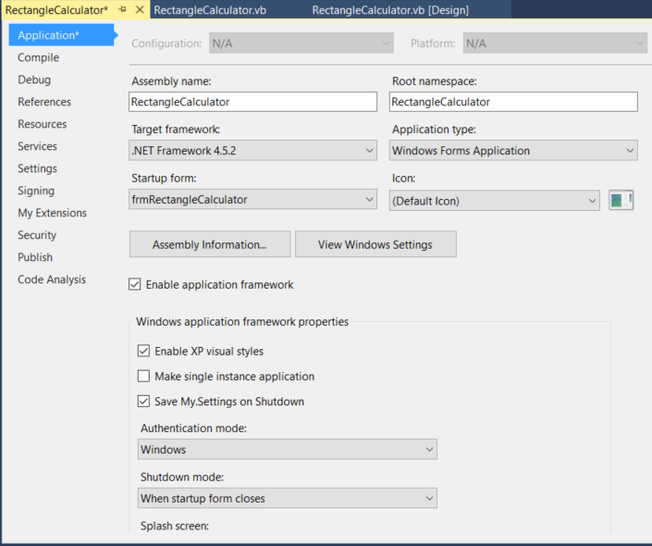
Project Properties
The project’s Properties window allows you specify the Startup form, Framework version and several other useful attributes
Project
(right click or use “My Project” to access Properties)

Slide 61
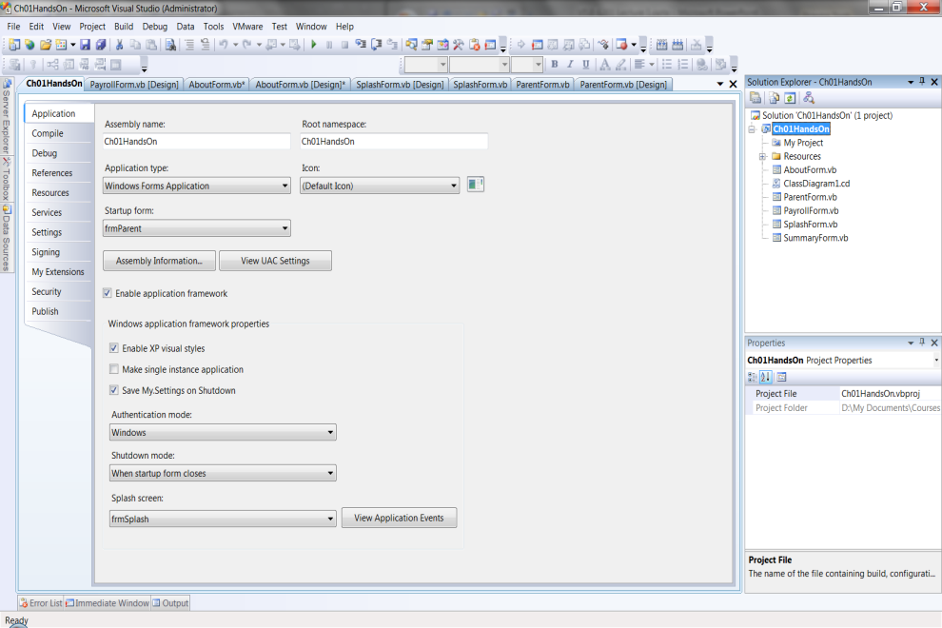
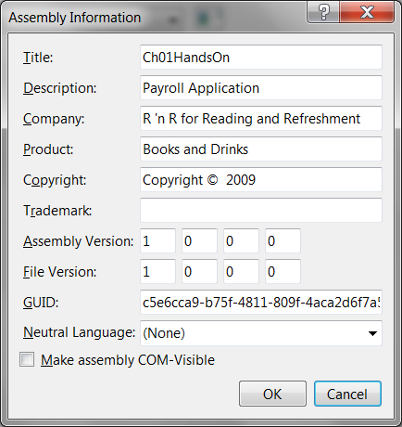
Assembly Information
View and edit the project’s assembly information by clicking the “Assembly Information…” button found on the project’s Properties window
Retrieve assembly attributes using My.Application.Info

Slide 62
Next Week
More Forms & UI Tips
Debugging Tips
Control Structures
Assignment 1

